Slide 1
Banq

Slide 2
Problem Statement
An app that tracks, manages and updates personal finances for college students tailored specifically to a life on campus. The app should be easy to use, detailed and centered around the everyday needs of an individual spending time on campus. The app should allow for tracking one’s expenses, channelising money and keeping track of incoming and outgoing cash flows.

Slide 3




Technology Stack

Slide 4
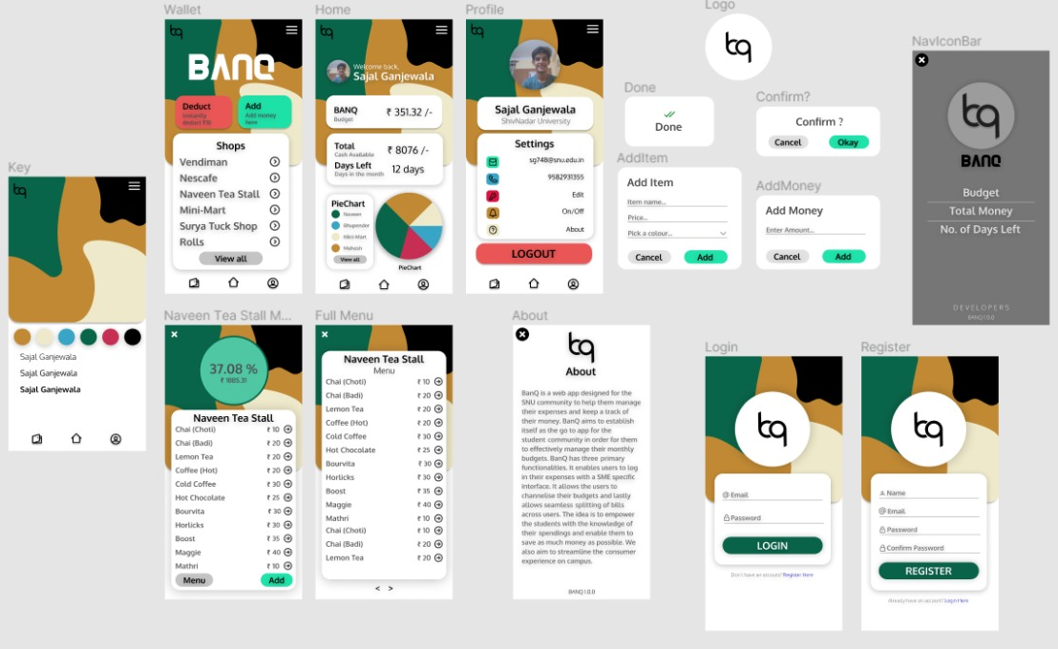
Figma Designs

Slide 5
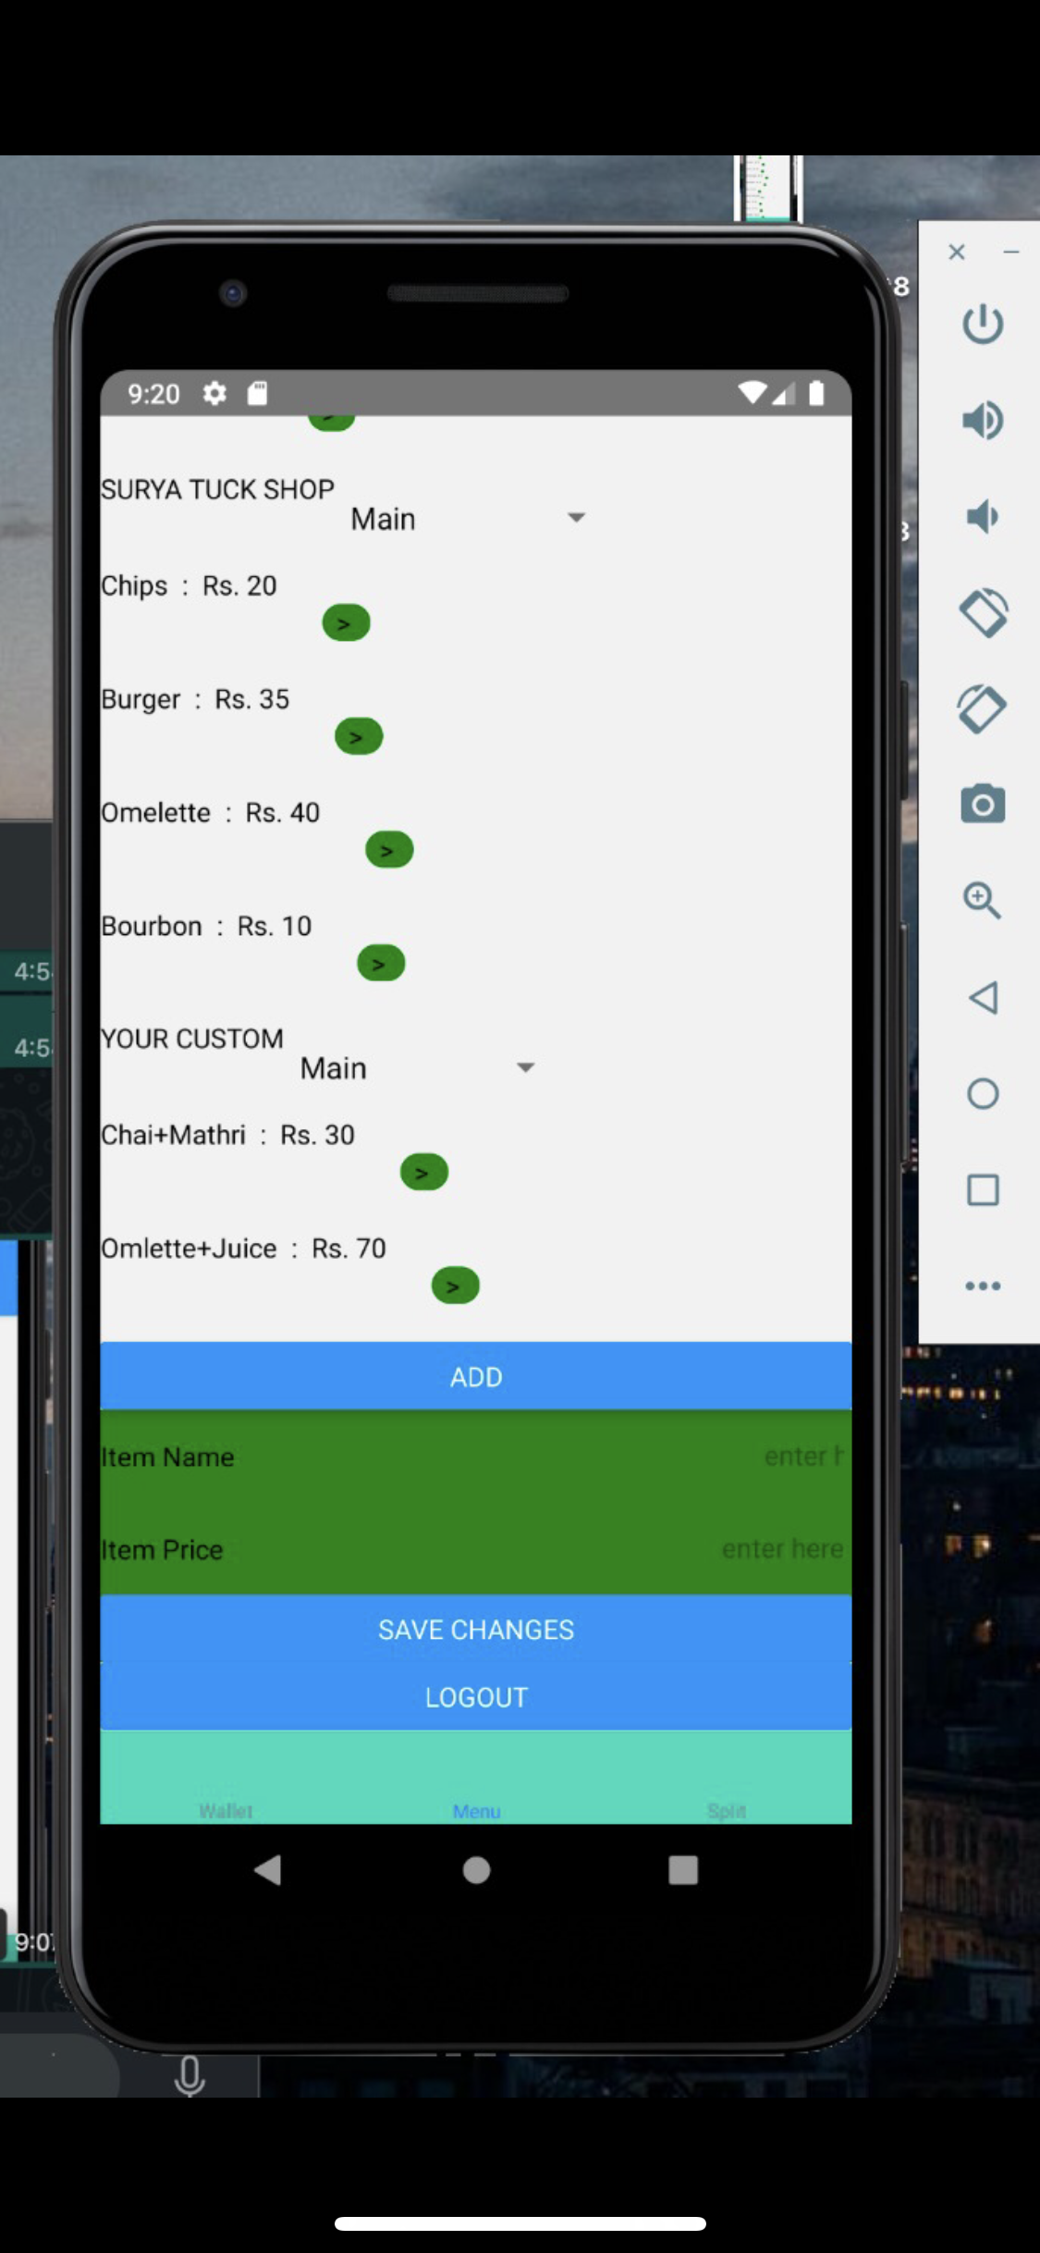
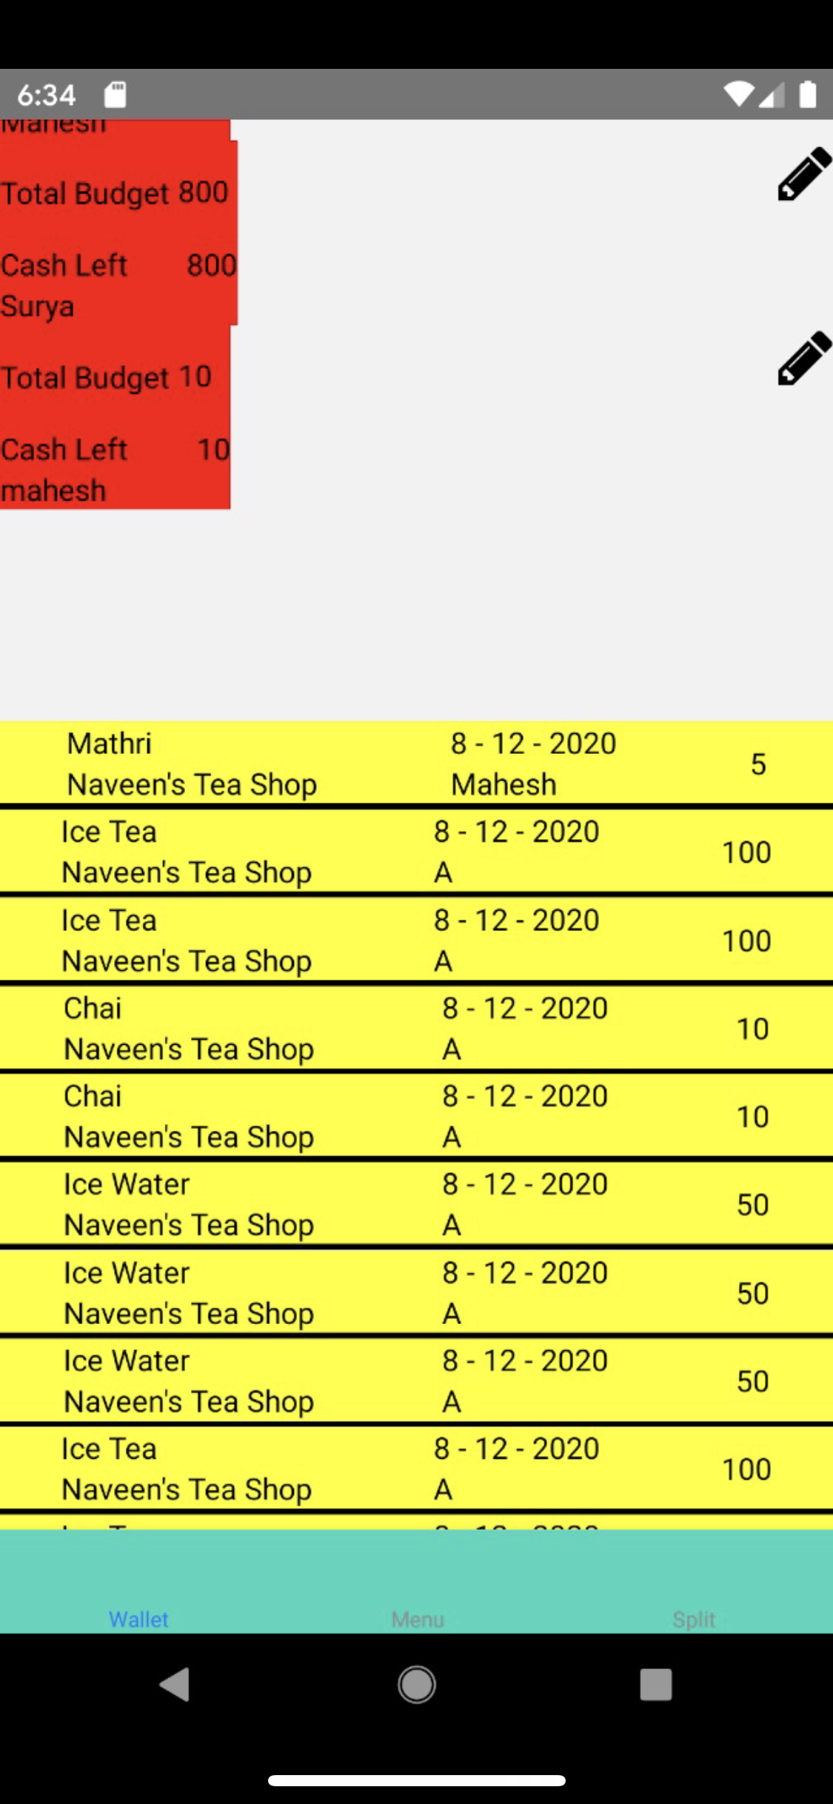
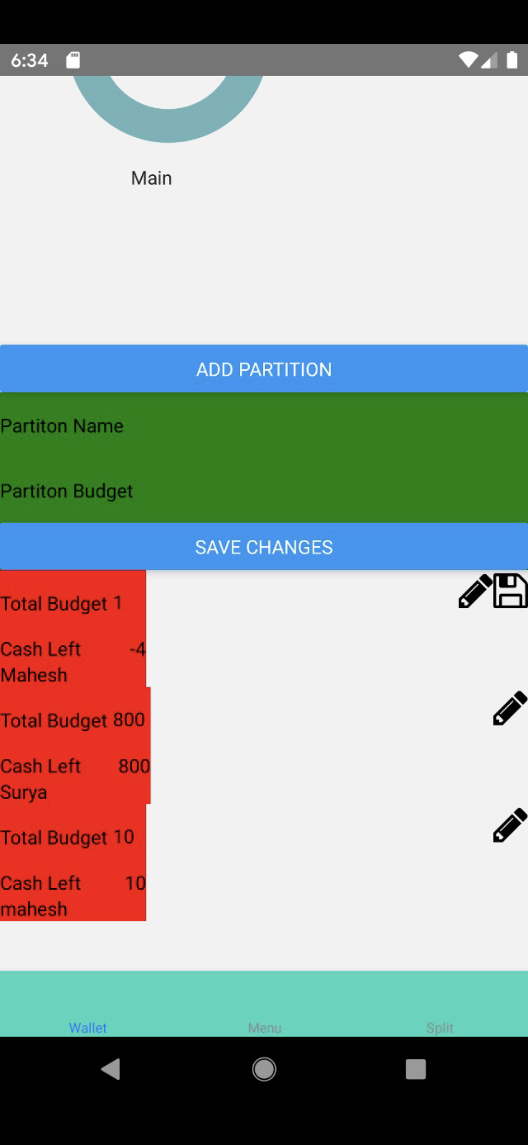
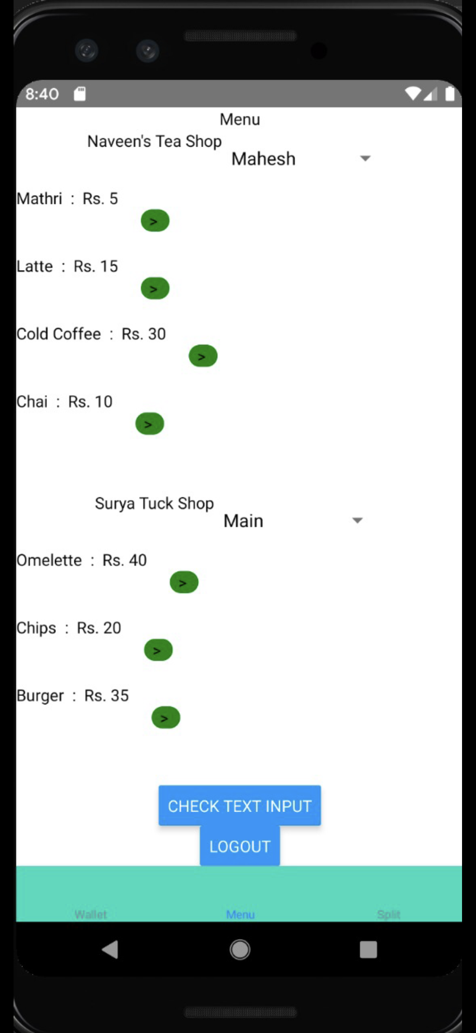
First Prototype

Slide 6
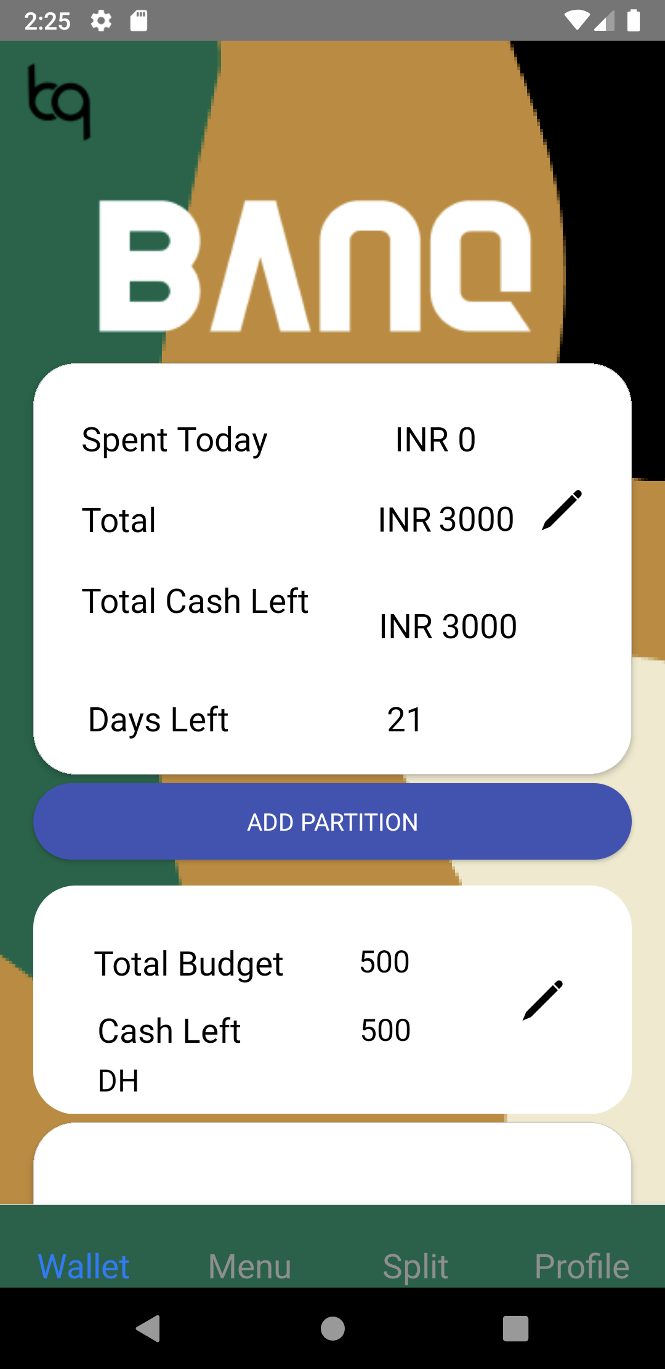
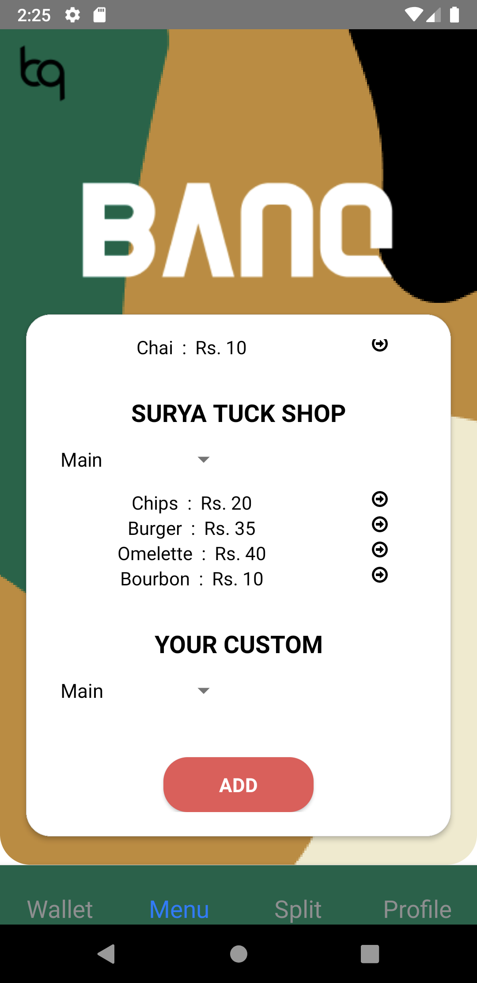
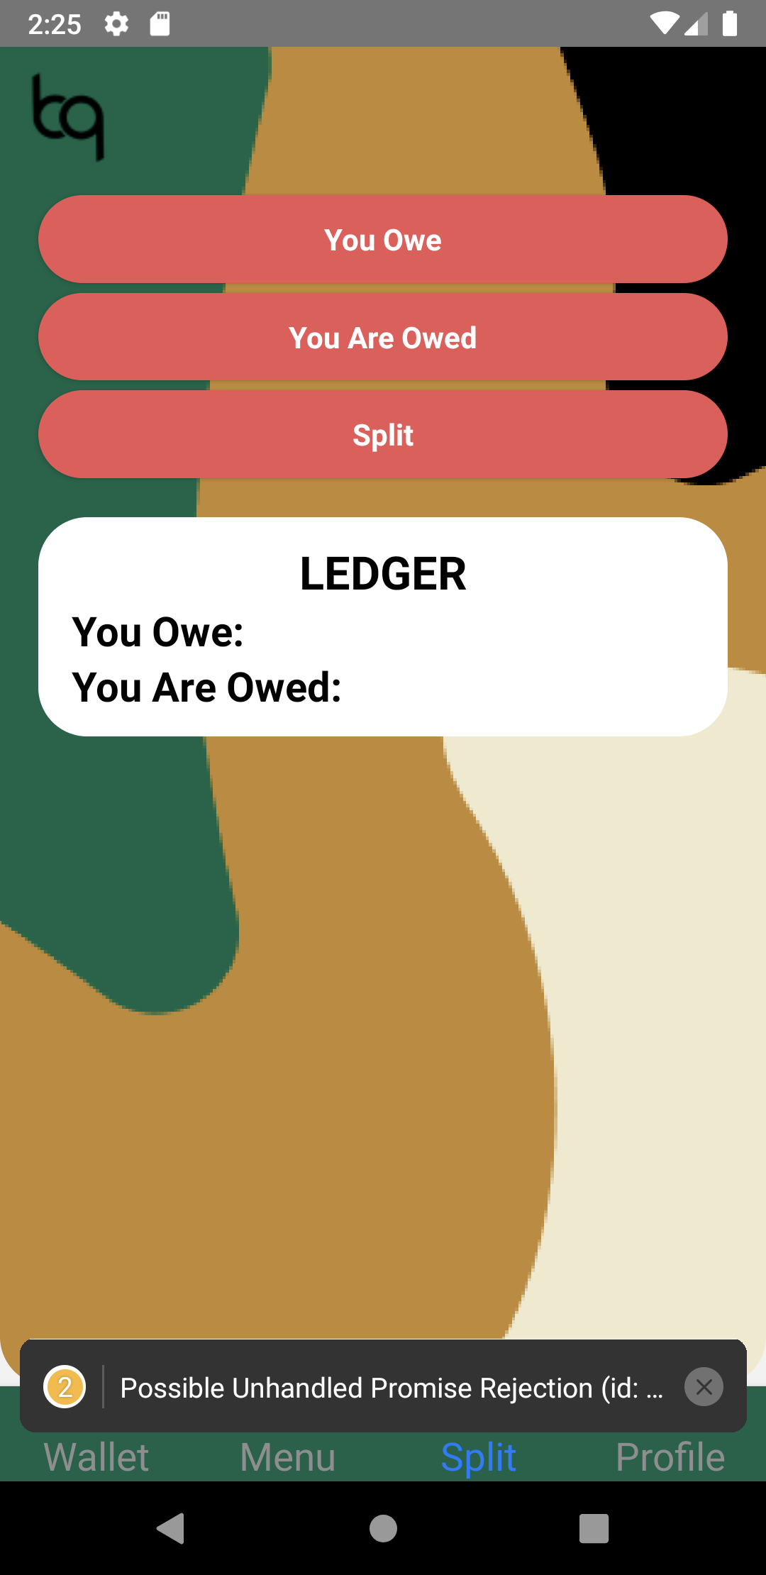
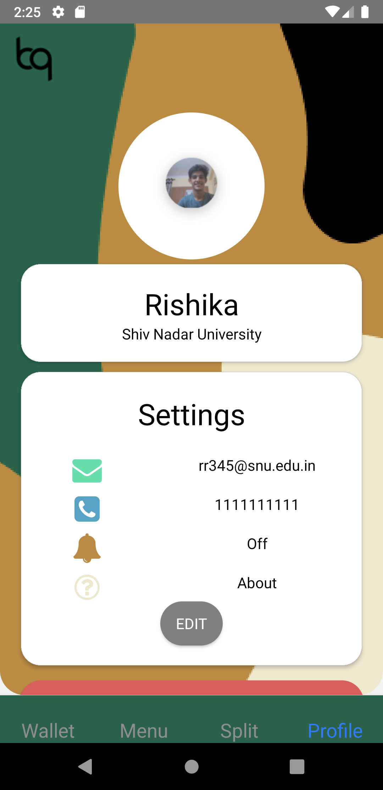
Final Screens

Slide 7
DEMO

Slide 8
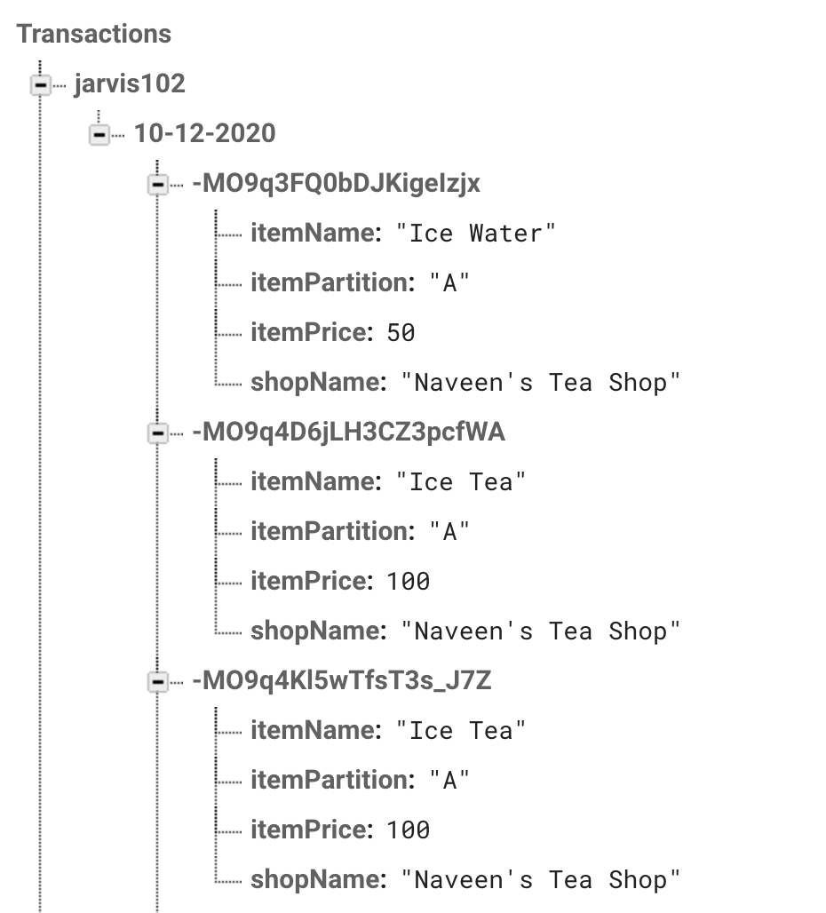
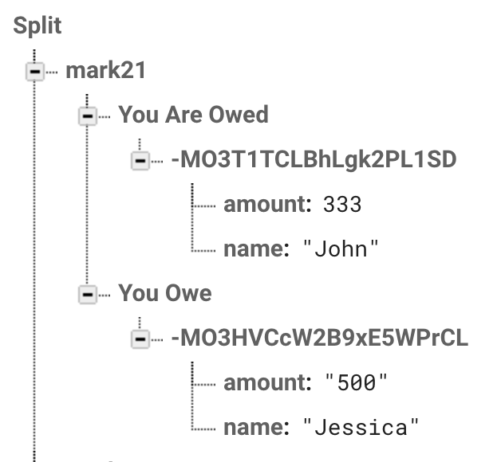
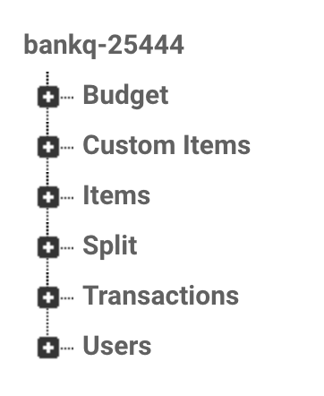
Database Structure

Slide 9
Testing
Only 1 partition in place
Case 1 - no money spent from partition and increase partition amount , no money spent from default - passed
Case 2 - no money spent from partitions and increase amount , money spent from default - passed
Case 3 - no money spent from partitions and decrease amount - no money from default - passed
Case 4 - no money spent from partitions and decrease amount - money from default - passed
Case 5 - money spent from partition and increase partition amount (no money spent from main)- passed
Case 6 - money spent from partition and increase portion amount (money spent from main) - passed
Case 7 - money spent from partition and decrease portion amount (no money spent from main) - passed
Case 8 - money spent from partition and decrease portion amount ( money spent from main) - passed
Multiple partitions in place
Adding a partition
Case 1 - no money spent from any partition and default - passed
Case 2 - no money from any partition but default its spent - passed
Case 3 - money spent from partitions and default is unspent - passed
Case 4 - money spent from partitions and default is spent - passed

